Slide 1
MEDB 5510 Clinical Research Methods
Week 10
Data Collection

Slide 2
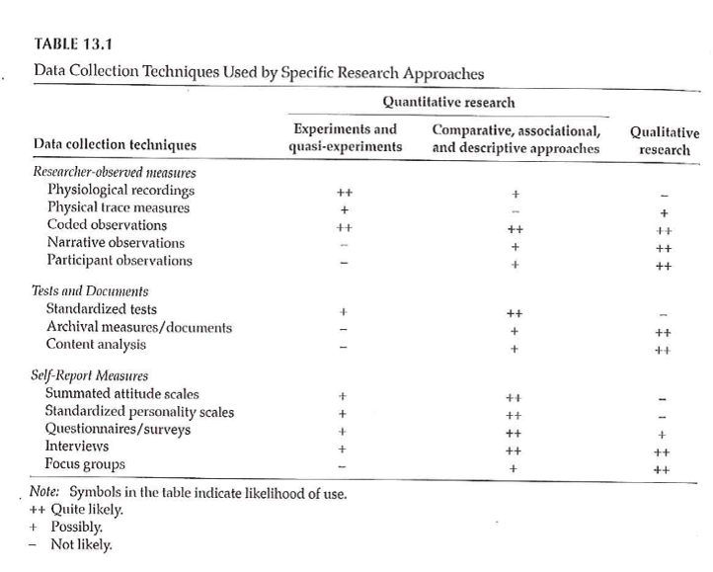
Data Collection Techniques

Slide 3
Data Collection Techniques
Standardized vs Investigator-Developed Instruments
Development and Use
Evidence to support investigator-developed instruments

Slide 4
Data Collection Techniques
Researcher-Observed Measures
Naturalness of the setting
Observer “participation”
Amount of detail
Breadth of coverage

Slide 5
Data Collection Techniques
Tests and Documents
Standardized tests
Norm referenced test
Criterion referenced test
Achievement tests
Performance and Authentic assessments
Aptitude tests
Documents
Content analysis

Slide 6
Data Collection Techniques
Self-Report Measures
Standardized Personality Inventories
Attitudes / Beliefs scales
Likert scale
Semantic differential scale
Questionnaires
How delivered / administered
Item types
Interviews
Focus groups

Slide 7
Descriptive Research
Surveys
Methods
Interview
Questionnaires
Design of surveys
Research question
Review of existing instruments
Process of designing survey

Slide 8
Data Collection Techniques
Surveys
Survey question format –
Open-ended
Close-ended
Wording of questions
Scales
Scale of measurement
Response options

Slide 9
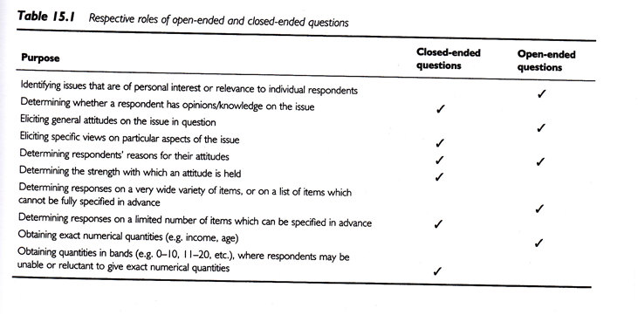
Data Collection Techniques
Open-ended vs Close-ended
Sim & Wright, 2002

Slide 10
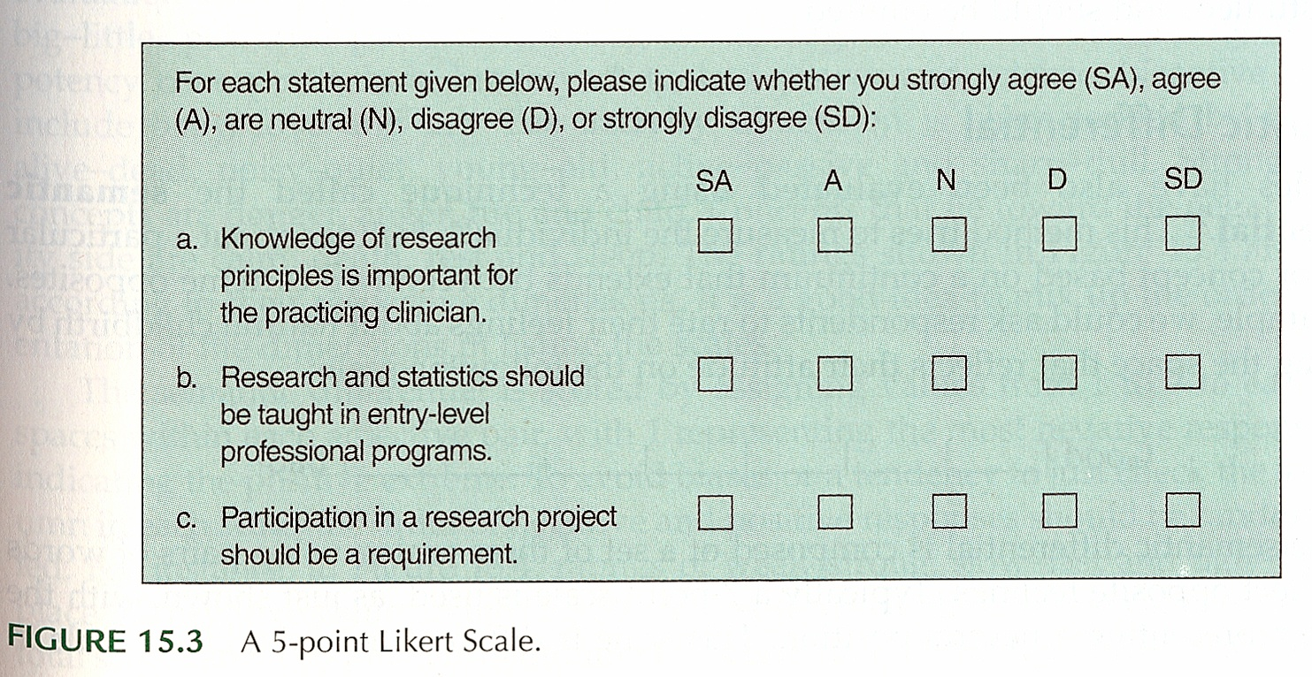
Data Collection Techniques
Surveys – Response Options
Likert
Portney & Watkins, 2009

Slide 11
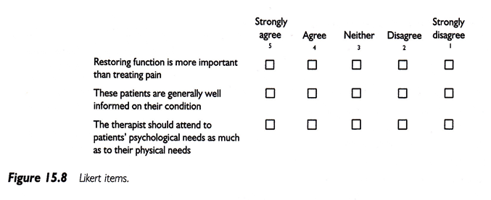
Data Collection Techniques
Surveys – Response Options
Likert
Sim & Wright, 2002

Slide 12
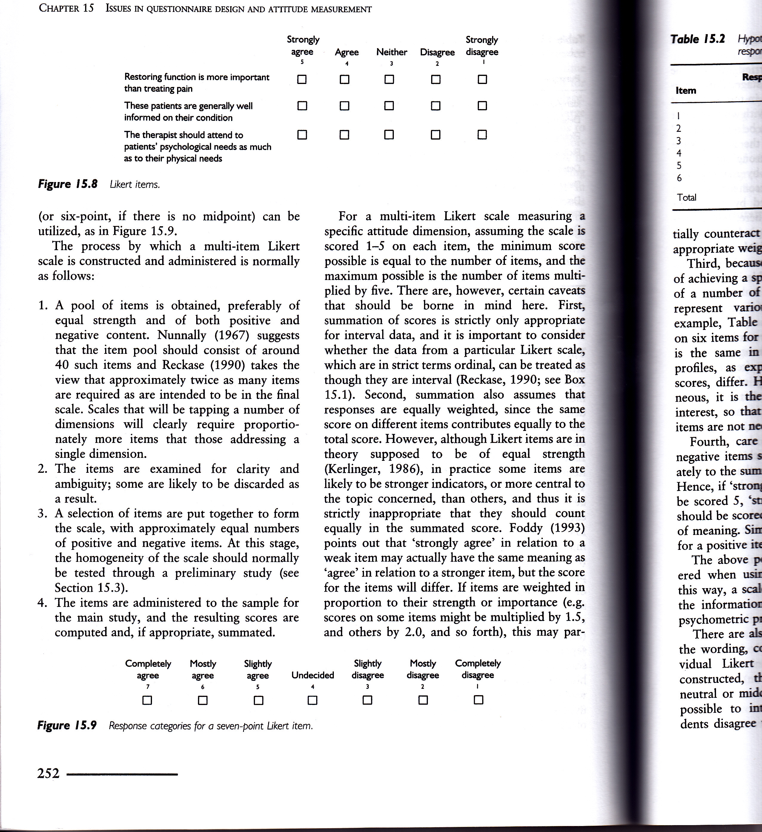
Data Collection Techniques
Surveys – Response Options
Likert
Sim & Wright, 2002

Slide 13
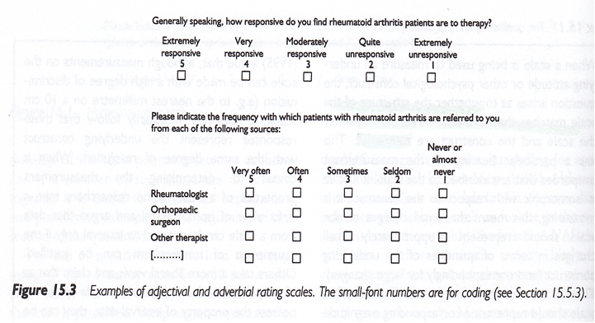
Data Collection Techniques
Surveys – Response Options
Sim & Wright, 2002

Slide 14
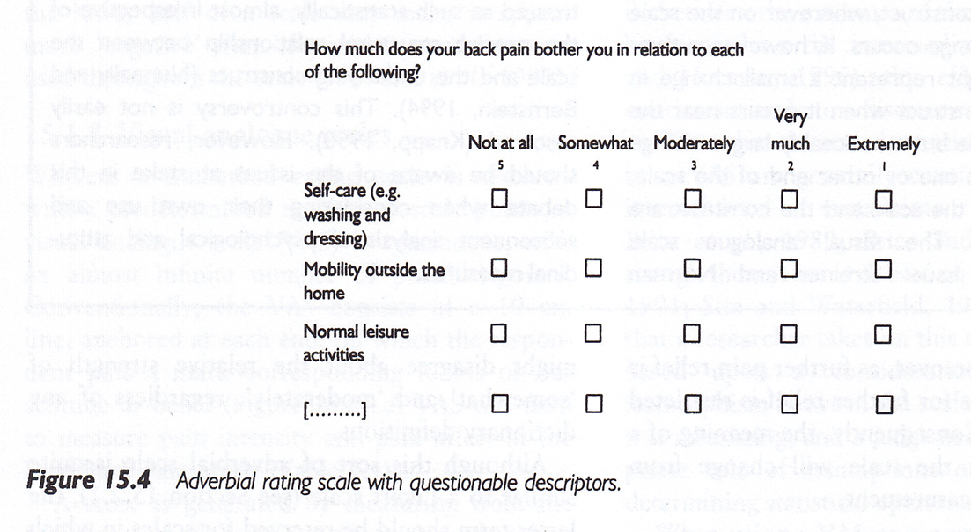
Data Collection Techniques
Surveys – Response Options
Sim & Wright, 2002

Slide 15
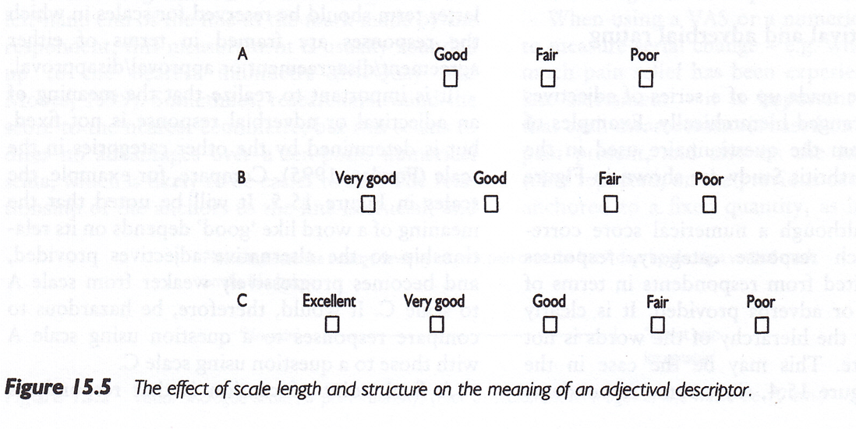
Data Collection Techniques
Surveys – Response Options
Sim & Wright, 2002

Slide 16
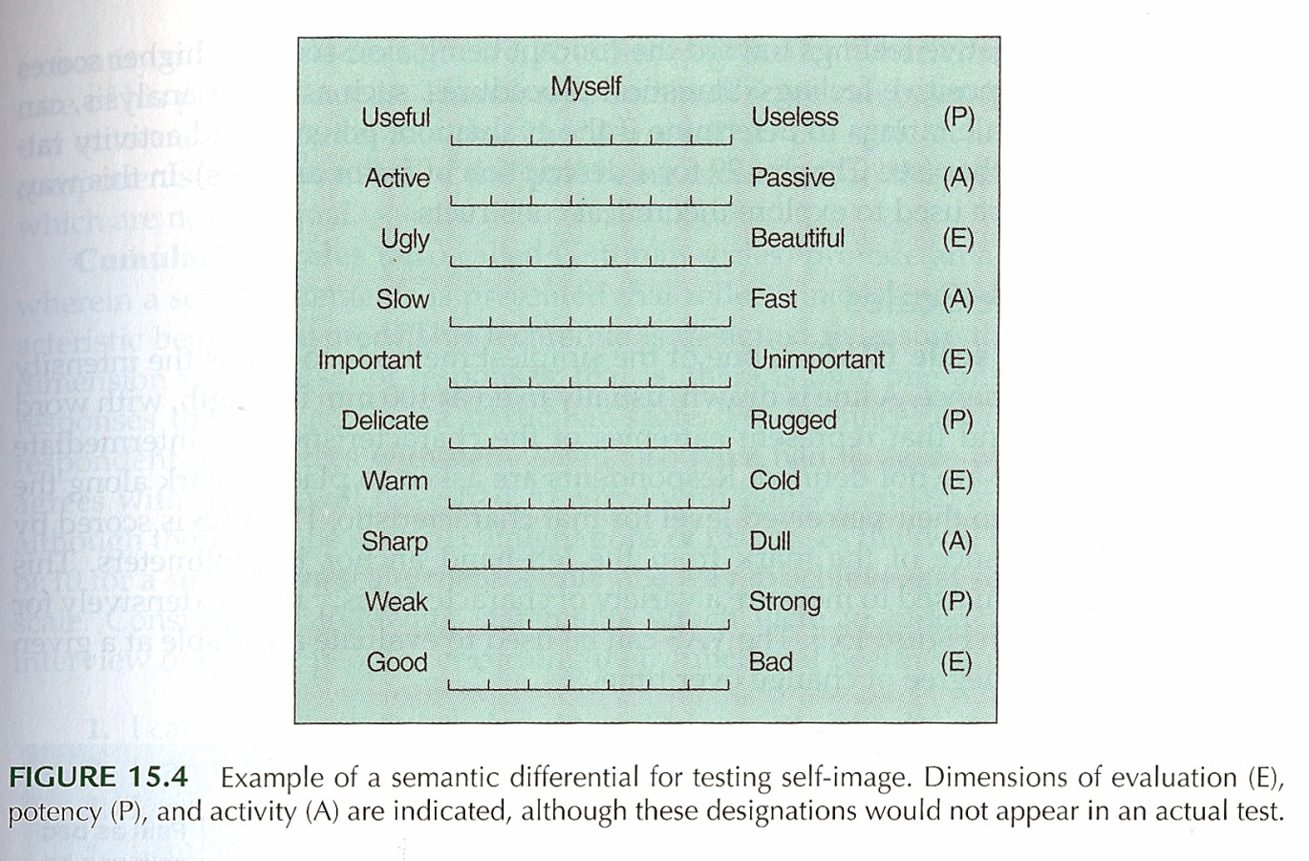
Data Collection Techniques
Surveys – Response Options
Semantic Differential
Portney & Watkins, 2009

Slide 17
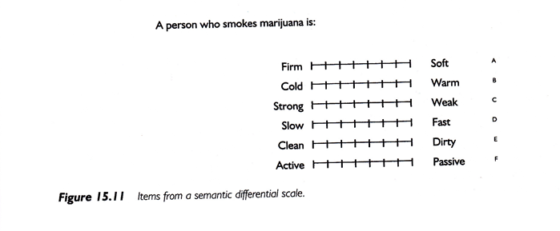
Data Collection Techniques
Surveys – Response Options
Semantic Differential
Portney & Watkins, 2009

Slide 18
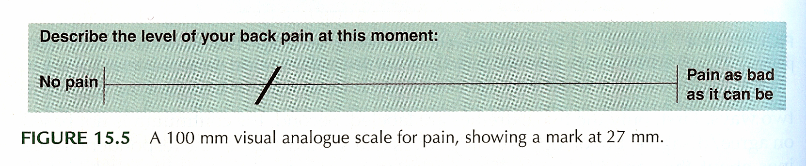
Data Collection Techniques
Surveys – Response Options
Visual Analogue Scale (VAS)
Portney & Watkins, 2009

Slide 19
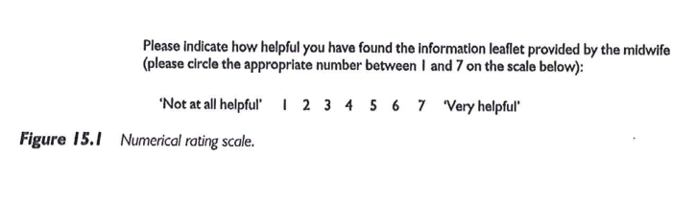
Data Collection Techniques
Surveys – Response Options
Numerical Rating Scale
Sim & Wright, 2002

Slide 20
Descriptive Research
Surveys
Pit-falls and words of caution
How responses are recorded
Wording of items
Literacy level
“Loaded” wording
Complexity of items
More than 1 “unit” in a single item
Clearly stated terms

Slide 21
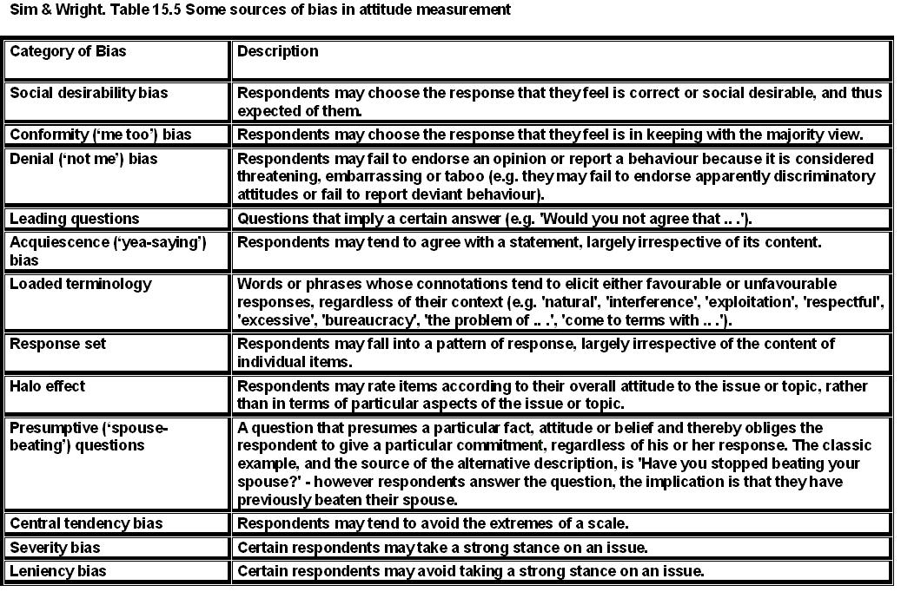
Data Collection Techniques
Surveys

Slide 22
Data Collection Techniques
Surveys – Example
Using a scale of 0 to 100, please indicate the percentage of time you take all the doses of your medicine?
… take all the pills in each of your doses?
… take all doses on the prescribed schedule?
… follow all special instructions …
… make sure you refill all of your medications on time?

Slide 23
Data Collection Techniques
Process of developing a survey
List of measures/variables
What’s already available?
Put the pieces together
Test and revise as needed
Final check – do you really need all of the items?
Analysis of survey data

Slide 24
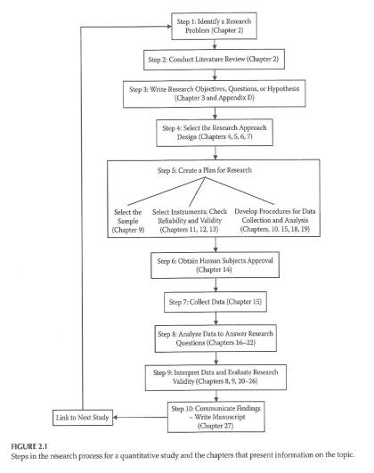
Data Collection & Coding

Slide 25
Data Collection & Coding
Initial Steps
Planning the study
Pilot testing
Data collection
Check for completeness if possible

Slide 26
Data Collection & Coding
Data Coding, Entry, and Checking
Guidelines
Mutually exclusive levels
Code for maximum information
Record is as complete as possible
Consistency
Data entry form
Checking entry

Slide 27
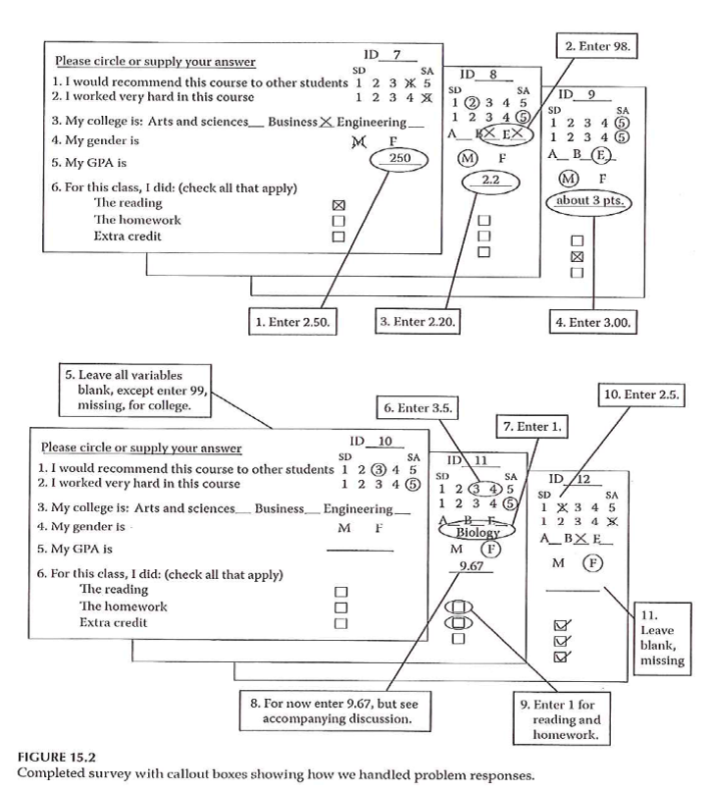
Data Collection & Coding

Slide 28
Data Collection & Coding
Data Entry into Statistical Program
Layout of data sheet
Variable names
Labeling
Variables
Values
Codebook / documentation

Slide 29
Data Collection & Coding
Data Summation
Descriptive information
Categorical variables
Continuous variables
Data checking – part 2

Slide 30
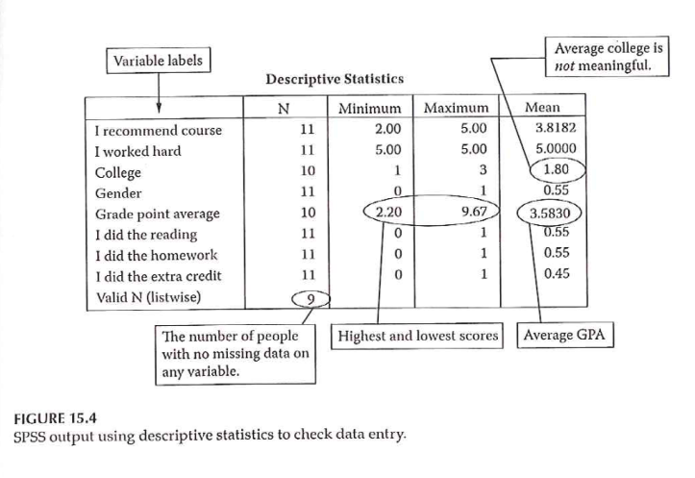
Data Collection & Coding

Slide 31
Assignment #8
Further refine your list of variables by specifying how each will be measured. Wherever appropriate, include the name of a specific measure. Do this by building onto the methods section of your research proposal draft.

